Slide 1
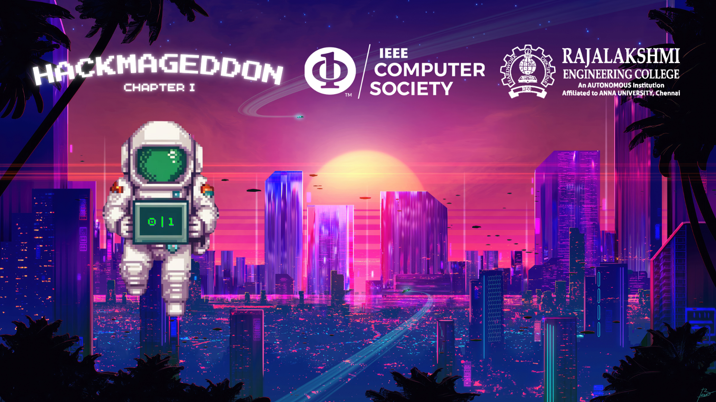
THEME: Health and Well-Being
PROBLEM STATEMENT ID: HG0220
PROBLEM STATEMENT: Affordable
Tele-ophthalmology Platform for Vision Screening
TEAM NAME: CodeDNA
TEAM LEADER NAME: Niranjana A

Slide 2

ABSTRACT
One in five Indians suffer from vision loss, with 9.2 million being completely blind. Considering the 2020 Indian population, 270 million are affected - this equates to an overall vision loss rate of 19.3%, placing India among the countries with the highest prevalence of vision impairment.
90% of this vision loss is preventable or treatable if diagnosed early.
An affordable teleophthalmology platform saves time, cost, and effort from ophthalmologists – quickening diagnosis and earning “lost time” for more people to be treated.
Im(AI) (pronounced /ɪmɐɪ̯/, from Tamil word இமை ) is a comprehensive teleophthalmology platform for complete vision screening – right from start to end.
Optimized for the Indian environment, Im(AI) uses ML models to screen for retinal diseases and sends the diagnosis along with the affected images directly to the ophthalmologist.
Imai can be a potential solution to vision care in underserved areas, with various features ensuring a complete diagnostic experience with no compromise on health.
¹Trends in prevalence of blindness and distance and near vision impairment over 30 years: an analysis for the Global Burden of Disease Study, The Lancet Global Health, 2021

Slide 3





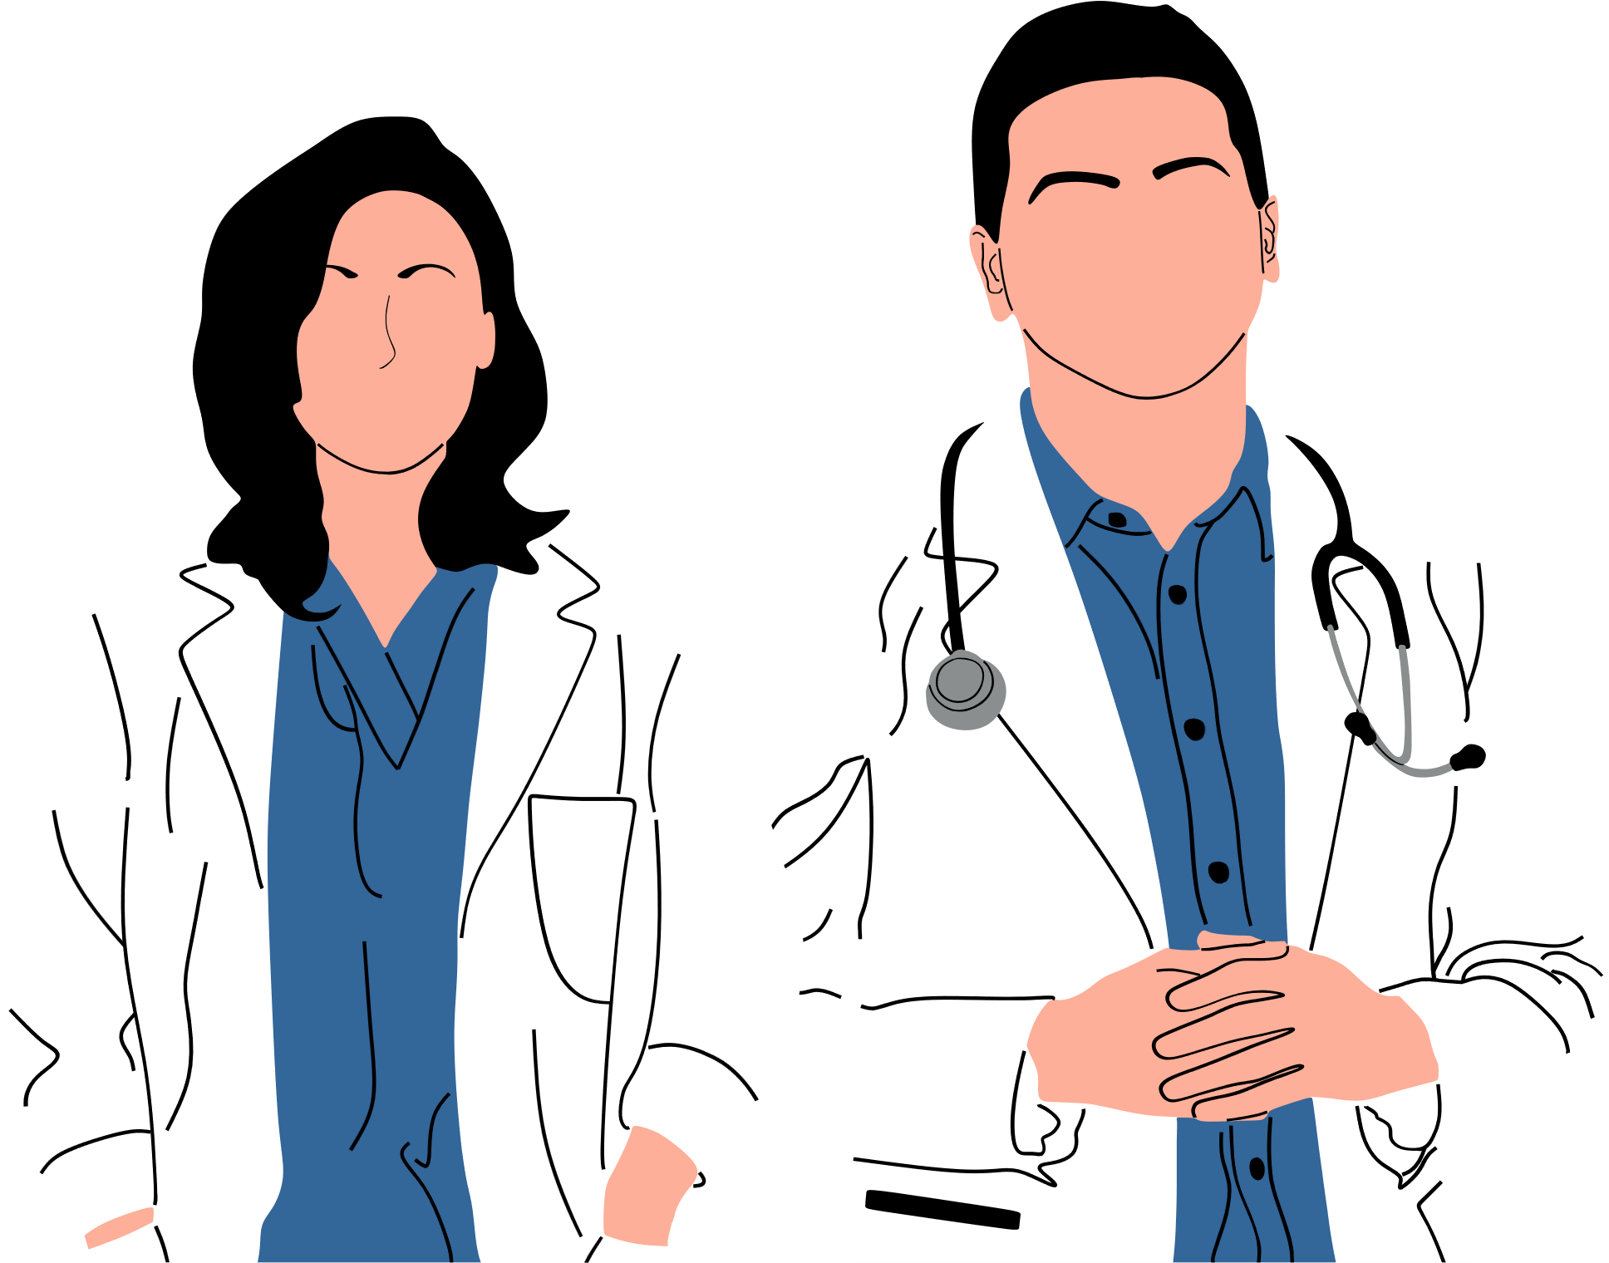










IDEA/APPROACH DETAILS
FLOW CHART
IDEA/SOLUTION
Online
consultation
No more hassle of travelling – with a diagnosis already done, just discuss the treatment online
Multi-user login
One-stop app for patients, technicians, nurses and doctors
Easily acquired images
A low-cost portable fundus camera attachable to a mobile phone captures images.
ML-assisted diagnosis
Disease detection using AI from scans and patient history
Tentative diagnosis saves doctor’s time
One-stop solution for all vision tests
Integrated vision tests reduce the need for multiple equipment
Language customization
Choose regional languages
Nurse for Assistance
Rural areas with minimal healthcare access
Vision Test Data & Patient History stored in Database
ML Model for Smart Screening & Diagnosis
Doctor Verification & Teleconsultation
TECH-STACK
Web Development
Machine Learning
Database
App Development

Slide 4





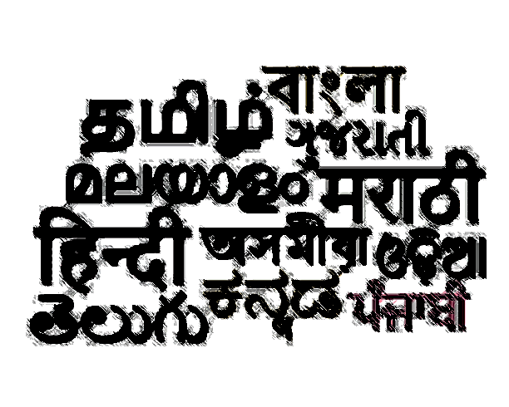



IDEA/APPROACH DETAILS
USE CASES
SHOW STOPPERS
Rural Vision Screening Camps - In collaboration with local NGOs and healthcare workers, vision screening camps can be organized in rural areas where healthcare access is limited.
School Vision Screening Programs - Schools in underserved areas can use the platform to conduct regular vision screenings for students.
Remote Diabetic Retinopathy Screening - Diabetic patients in remote areas can be regularly screened for diabetic retinopathy using the platform.
Corporate Wellness Programs - Companies can implement vision screening as part of their employee wellness programs, particularly for employees in remote or underserved areas.
Community Health Worker Assisted Screenings - Community health workers (CHWs) can use the platform to conduct vision screenings during routine visits in underserved areas.
Urban Slum Health Initiatives - Vision screening services can be extended to urban slum areas where access to healthcare is often limited.
Integrated ML Model - Capture and upload eye images for analysis and diagnosis
Video calls/chats with eye care professionals - discuss diagnoses & treatment plans remotely
Integrated vision tests - Snellen chart and color assessments for initial diagnostic insights
Aid follow-up tests & appointments, ensuring continuous monitoring and management of eye.
Ensures patient privacy by secure storage of medical records
Mitigates language barriers by integrating regional languages
Reduces manpower required to conduct an eye camp in a rural area by half
Versatile subscription models to meet the needs of every facility

Slide 5

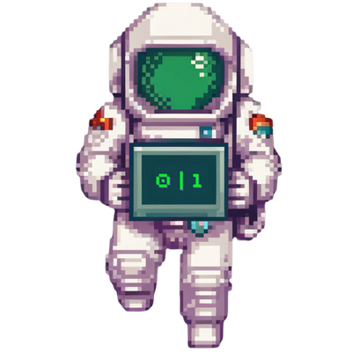
TEAM MEMBER DETAILS
Team Leader Name: Niranjana A
Branch: B.E. Department: Biomedical Year:III
Engineering
Team Member 1: Anjali G S
Branch: B.E. Department: Biomedical Year:III
Engineering
Team Member 2: Dinisha Selvakumari B
Branch: B.E. Department: Biomedical Year:III
Engineering
Team Member 3: Sajiv Jess
Branch: B.Tech. Department: Artificial Intelligence Year:II
and Machine Learning
Team Member 4: Akash Vardhan
Branch: B.Tech. Department: Artificial Intelligence Year:I
and Machine Learning

